Slide 1
Conditionals – part 4
Barb Ericson
Georgia Institute of Technology
August 2005

Slide 2
Learning Goals
Understand at a conceptual and practical level
  How to change the background on a picture?
  How to do chroma key?

Slide 3


Background Replacement
If you have a picture of a person in front of some background
And a picture of the background itself
Can you replace the pixel colors for the background to be from another image?

Slide 4
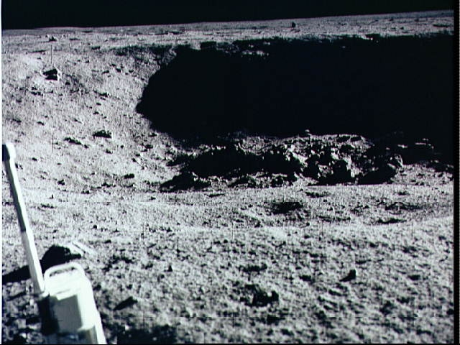
Replace Background
Replace the colors at all the pixels in the source image
  That are within some range of the background color
  Use pixels from another background image

Slide 5
Replace Background Algorithm
Works on the source picture
  Pass in the original background and the new background pictures
Loop through all the pixels in the source image
  Check if the distance from the source pixel color is within 15.0 of the background picture pixel color
    If so replace it with the color at the new background pixel

Slide 6
Replace Background Method
public void swapBackground(Picture oldBackground,
Picture newBackground)
{
Pixel currPixel = null;
Pixel oldPixel = null;
Pixel newPixel = null;
// loop through the columns
for (int x=0; x<this.getWidth(); x++)
{
// loop through the rows
for (int y=0; y<this.getHeight(); y++)
{

Slide 7
Swap Background - Cont
// get the current pixel and old background pixel
currPixel = this.getPixel(x,y);
oldPixel = oldBackground.getPixel(x,y);
/* if the distance between the current pixel color
* and the old background pixel color is less than the 15
* then swap in the new background pixel
*/
if (currPixel.colorDistance(oldPixel.getColor()) < 15.0)
{
newPixel = newBackground.getPixel(x,y);
currPixel.setColor(newPixel.getColor());
}
}
}
}

Slide 8
Testing swapBackground
Picture p1 = new Picture(FileChooser.getMediaPath(“kid-in-frame.jpg”));
Picture oldBack = new Picture(FileChooser.getMediaPath(“bgframe.jpg”));
Picture newBack = new Picture(FileChooser.getMediaPath(“moon-surface.jpg”));
p1.swapBackground(oldBack,newBack);
p1.show();
Notes:
You can type all of the first bullet on one line in DrJava (it just didn’t fit on the slide here).

Slide 9
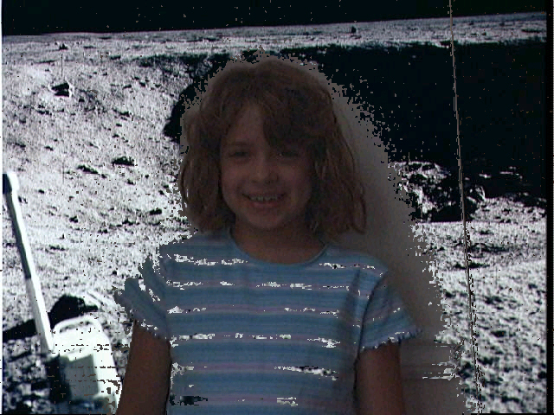
Replace Background Result
The background color was too close to the shirt color
Notes:
The source picture was kid-in-frame.jpg in mediasources. The old background was in bgframe.jpg. The new background was in moon-surface.jpg.

Slide 10
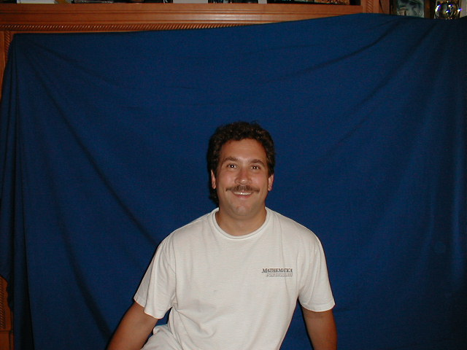
Chroma Key – Blue Screen
For TV and movie special effects they use a blue or green screen
  Here just a blue sheet was used
  Professionally you need an evenly lit, bright, pure blue background
    With nothing blue in the scene
Notes:
See http://entertainment.howstuffworks.com/blue-screen.htm for more information

Slide 11
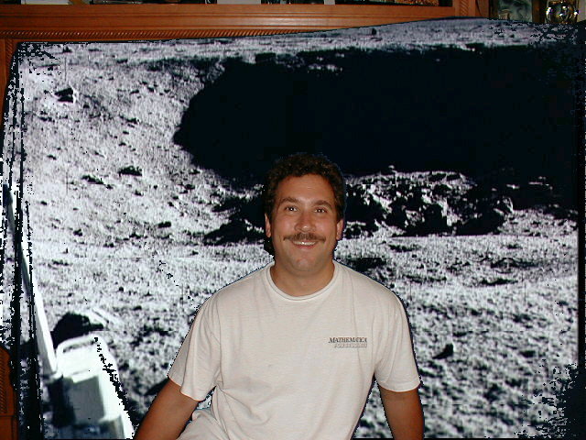
Chroma Key Exercise
Write the method chromakey that takes a new background picture as an input parameter
  It will loop through all the pixels
  If the pixel color is blue (red + green < blue)
  Replace the pixel color with the color from the new background pixel (at the same location)
Notes:
The source picture is blue-mark.jpg. The blue background is blue-empty.jpg. The moon picture is moon-surface.jpg.

Slide 12
Testing chromakey
Picture markP = new Picture(FileChooser.getMediaPath(“blue-mark.jpg”));
Picture newBack = new Picture(FileChooser.getMediaPath(“moon-surface.jpg”));
markP.chromakey(newBack);
markP.show();

Slide 13
Summary
To swap the background of a picture
  Take a picture with a person in the scene
  And a picture without the person in the scene
  Change the pixel color to the new background color
    If the distance from the current pixel is within a distance to the old background color
To chromakey
  Take a picture of a person in front of a blue screen
  Change the pixel color to the new background color
    If the blue value is greater than the red + green (for blue screen)

